Slide 1
Exercise - NFC Cabinet Lock UID Cloning
Prep: Giving out the instructions, NFC Lock+Key and
a Flipper Zero to each group.
Instructions
NFC Cabinet Lock + Master Key
Flipper Zero

Slide 2
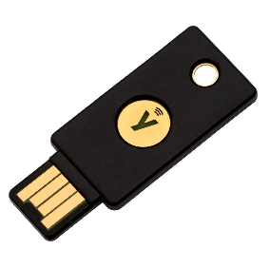
NFC Authentication Types
UID Authentication
  Insecure - relies on uniqueness of a NFC tag UID
Data based authentication
  Key is stored in the sector or page data of the NFC tag
Challenge–response authentication
  HMAC-SHA1 algorithm
  PAM Module - Pluggable Authentication Module
  Can be extremely difficult to clone/emulate

Slide 3
Exercise - NFC Password Protection & Brute Force
Prep: Giving out the instructions, NTAG215 tag to each student and a reader to each group.
Instructions
VM from thumb drive
ACR122U Reader
NTAG215 Tag (Round white tag)

Slide 4
Playing with NFC – Reading/Writing: (with ACR122U)
You could also use an PN532
Make sure you do the following for both ACR122U & PN532:
  Click on USB icon on top of the VM window 🡪 “USB & Bluetooth Settings”
  Make sure you have the following:
Notes:
Refs:
https://www.linux.org/threads/usb-serial-device-does-not-appear-as-dev-ttyusb.23105/
https://www.kali.org/docs/general-use/updating-kali/

Slide 5
